Slide 1
Data Engineering
Episode 2
Data Modeling with NoSQL

Slide 2
Overview
When is SQL not so great?
What is NoSQL?
CAP Theorem
Apache Cassandra
How is Cassandra Data Modeling Different?
Key Tenets
Primary Keys
Grouping Columns
CQL - Cassandra Query Language
Demo - Sparkify Modeling in Cassandra
Questions?

Slide 3
When is SQL not so great?
Need high Availability in the data: Indicates the system is always up and there is no downtime Have Large Amounts of Data
Need Linear Scalability: The need to add more nodes to the system so performance will increase linearly
Low Latency: Shorter delay before the data is transferred once the instruction for the transfer has been received.
Need fast reads and write

Slide 4
What is NoSQL?
NoSQL (Not Only SQL) is designed to address some of the issue w/ SQL
SQL databases are generally about 95% the same in syntax, while NoSQL systems are not
Architectural Differences
Simpler Design
Horizontal Scaling
Finer control of availability
Designed to serve specific queries
Common NoSQL Options
Casandra – Partitioned Row Store
MongoDB – Document Store
DynamoDB – Key Value Store
HBase – Wide Column Store
Neo4j – Graph Db

Slide 5
How is TDS Addressing the need for speed?
Currently, there are mostly relational database deployments
We have not reached the point where the need for speed is more important than the need for guaranteed transactions (distributed systems are accurate eventually aka in milliseconds)
Typically this would happen if we needed a high level of reads and writes
Techniques such as materializing and indexing data are being used
Views created in this way are often intentionally denormalized so that BI Tools (Webi, Tableau etc) can more easily use them
They are often indexed so that specific queries run very fast (RAP and Customer Network usage are examples of that)
High Read/Write Production Issues
DHCP (UAS outage DST change ‘17)
Authoritative DNS (‘16 when a blank zone file was pushed out)
Using the Database as a queue (Inat, Eeps etc)

Slide 6
What is Apache Cassandra?
What is it?
The Apache Cassandra database is the right choice when you need scalability and high availability without compromising performance. Linear scalability and proven fault-tolerance on commodity hardware or cloud infrastructure make it the perfect platform for mission-critical data. Cassandra's support for replicating across multiple datacenters is best-in-class, providing lower latency for your users and the peace of mind of knowing that you can survive regional outages.
How is it being used?
Netflix (video serving)
Transaction logging (retail, health care)
IOT (Internet of Things)
Time series data
Any workload that is heavy on writes to the database (since Apache Cassandra is optimized for writes).

Slide 7
Terms related to Cassandra
Key space – collection of tables
Table – a group of partitions
Row – a single item
Partition – Fundamental unit of access, a group of rows, and how data is distributed
Primary Key – Partition key + Clustering Columns
Columns – Clustering or Data
Clustering Column - Part of a table’s primary key
Data Columns - Data elements not used for searching / grouping

Slide 8
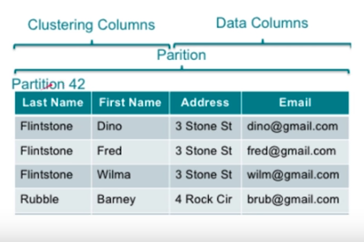
Terms in Practice

Slide 9
Cap Theorem
Consistency: Every read from the database gets the latest (and correct) piece of data or an error
Availability: Every request is received and a response is given -- without a guarantee that the data is the latest update
Partition Tolerance: The system continues to work regardless of losing network connectivity between nodes
Any system can only guarantee 2 of the above

Slide 10
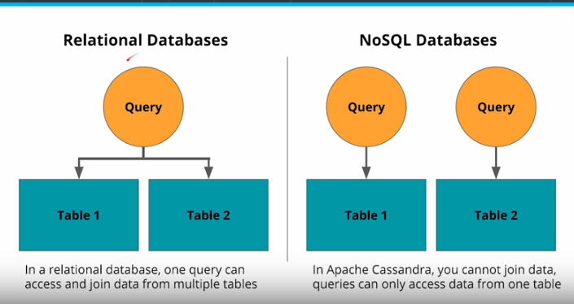
Cassandra in Practice (2)

Slide 11
Data Modeling Differences
Denormalization is not just okay -- it's a must
Denormalization must be done for fast reads
Apache Cassandra has been optimized for fast writes
ALWAYS think Queries first
One table per query is a great strategy
Apache Cassandra does NOT allow for JOINs between tables
You can't move relational DB schemas as is to NoSQL
You can’t model in Cassandra w/o knowing the query

Slide 12
Primary Key
Must be unique - Duplicate Keys will be overwritten
The PRIMARY KEY is made up of either just the PARTITION KEY or with the addition of CLUSTERING COLUMNS
A simple PRIMARY KEY is just one column that is also the PARTITION KEY. A Composite PRIMARY KEY is made up of more than one column and will assist in creating a unique value and in your retrieval queries
The PARTITION KEY will determine the distribution of data across the system

Slide 13
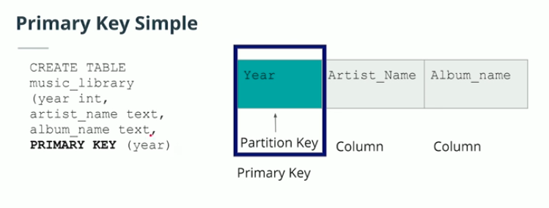
CQL
Cassandra Query Language - Based on SQL (Designed to be easy to pickup)
Table Create Example

Slide 14
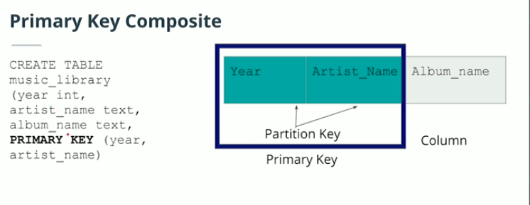
CQL (2)

Slide 15
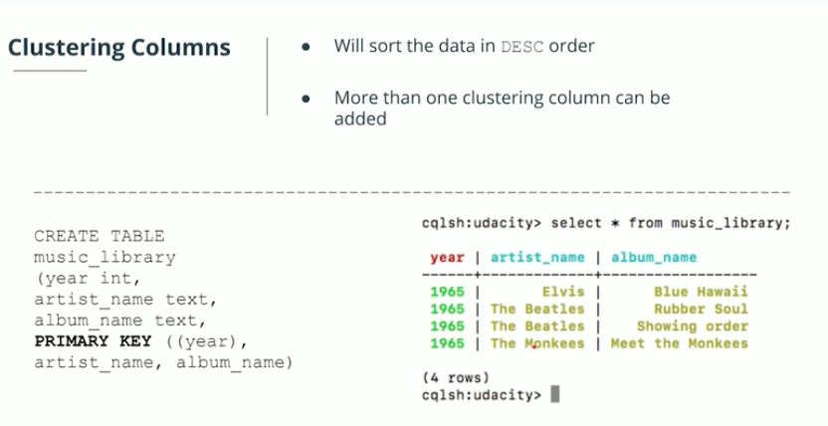
Clustering Columns
Sorts Data in Sorted Descending Order

Slide 16
Where Clauses
WHERE clause
Data Modeling in Apache Cassandra is query focused, and that focus needs to be on the WHERE clause
Failure to include a WHERE clause will result in an error
ALLOW FILTERING will allow you to not use a where clause but causes a huge performance hit

Slide 17
Demo
A startup called Sparkify wants to analyze the data they've been collecting on songs and user activity on their new music streaming app. The analysis team is particularly interested in understanding what songs users are listening to. Currently, there is no easy way to query the data to generate the results, since the data reside in a directory of CSV files on user activity on the app.
They'd like a data engineer to create an Apache Cassandra database which can create queries on song play data to answer the questions, and wish to bring you on the project. Your role is to create a database for this analysis. You'll be able to test your database by running queries given to you by the analytics team from Sparkify to create the results.

Slide 18
Questions?

